Slide 1

Project Presentation Lattice Gas Automata (HPP, FHP)
01611822 Manuel Schieder
12129845 Ali Obeid

Slide 2
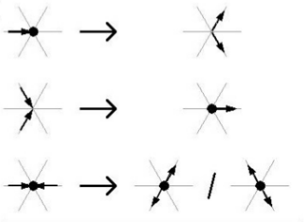

Introduction
HPP
Simple Model
Max. 4 Particles/Cell
16 possible states
1 collision rule
FHP
3 different Models
Up to 7 Particles/Cell
Up to 128 possible states
Up to 7 collision rule
[2]

Slide 3
Implementation
Node based Implementation
Apply collsion rules for particles
Apply collision rules at Boundaries & Obstacles
Propagate the particles
Average velocities for plotting
Domain
500x200 nodes
[2]

Slide 4
Implementation
Start
Is I < number of rows
Yes,
i+1
Grid Size
Time steps
Empty array for particles except in right direction
Obstacle location
Yes,
t+1
Is t < number of time-steps
No
Particles collide at non-boundary cells
Particles collide at boundary cells
Particles collide at obstacle cells
Propagate to next cell in each direction
Average the velocity over subdomains
Velocity vector graph
Contour of particles number
Is J < number of columns
Yes,
J+1
[2]
End
No
No

Slide 5
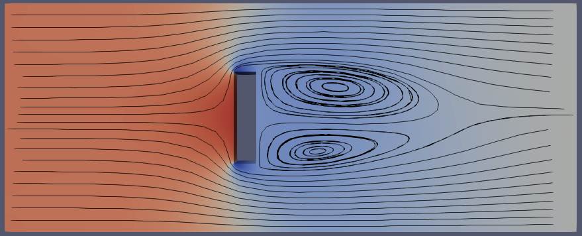
Test Case
[2]

Slide 6
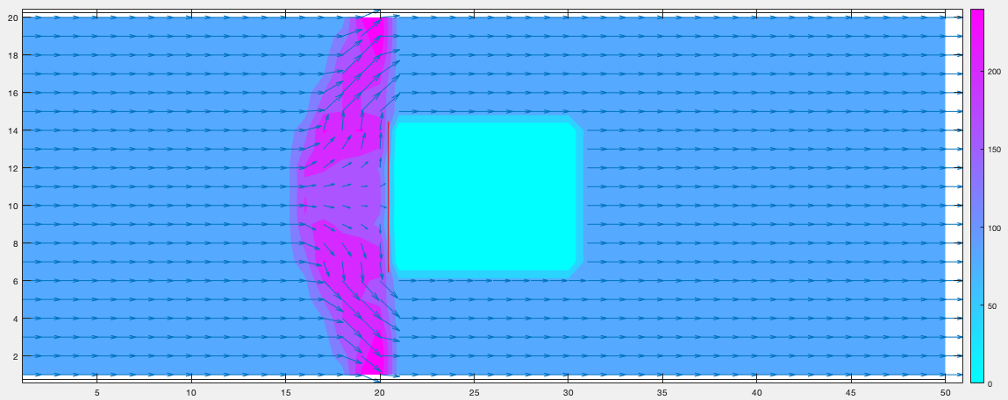
Results HPP
Particle density Contour with velocity vectors

Slide 7
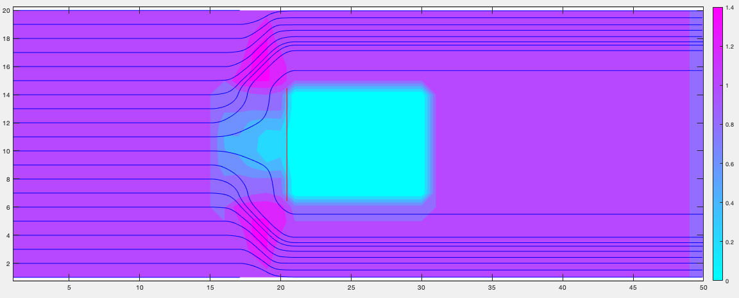
Results HPP
Velocity Contour with Streamlines

Slide 8
Results FHP
[2]

Slide 9
Karman Vortex Street
[2]

Slide 10
Conclusion
HPP
Good for a general idea of the flow field
No qualitative information about the flow
Energy is conserved (particles will never stop)

